Slide 1
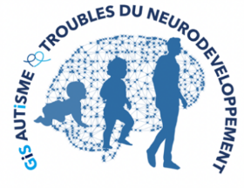
Training in the use of collaborative motor actions with and without the software resulting from the project
DELIVERABLE " Support
of Training".
LIMSI-CNRS
Jean-Claude MARTIN, Tom GIRAUD,
Brian RAVENET, Elise PRIGENT, Dorine CAQUERET
TEDyBEAR Center: Jacqueline NADEL, Justin MALLERET, Aurélie CHERRIER
https://mimetic.limsi.fr/
Work carried out by :
Project supported by :
TEDyBEAR

Slide 2
This deliverable was produced as part of the MIMETIC project "Software for training combined with cooperative social interaction and motor learning".
This project is the winner of the Call for Autism and New Technologies projects, coordinated by FIRAH and supported by the Orange Foundation and the UEFA Foundation for Children.

Slide 3
Who is this document intended for
This deliverable is intended in particular for interested caregivers to advance the motor collaboration of children with Autism Spectrum Disorder, with or without a device such as the MIMETIC platform.

Slide 4
The MIMETIC project
MIMETIC = Motricity autIsME activity Spousal activity
"Software for training combined with cooperative social interaction and motor learning".
This project is one winner of the Call for Autism and New Technologies 2016, coordinated by FIRAH and supported by the Orange Foundation and the UEFA Foundation for Children.

Slide 5
The MIMETIC project was carried out by
TEDyBEAR Center Paris-Est
Jacqueline NADEL
Justin MALLERET
Aurélie CHERRIER
LIMSI-CNRS
Jean-Claude MARTIN,
Tom GIRAUD,
Brian RAVENET,
Elise PRIGENT,
Dorine CAQUERET

Slide 6
Link to other deliverables
This booklet provides illustrations and can be used as a training aid for caregivers.
It is complementary to the following deliverables that are available on the project website:
Library of collaborative motor actions (videos)
Training Guide for Caregivers (Word document)

Slide 7
PLAN
. - Collaborative motor actions
. - Presentation of the platformMIMETIC
. - Training in collaborative motor collaboration with the MIMETIC platform
- Technique: components and assembly of the platform

Slide 8
COLLABORATIVE MOTOR ACTIONS

Slide 9
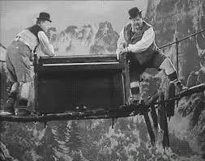
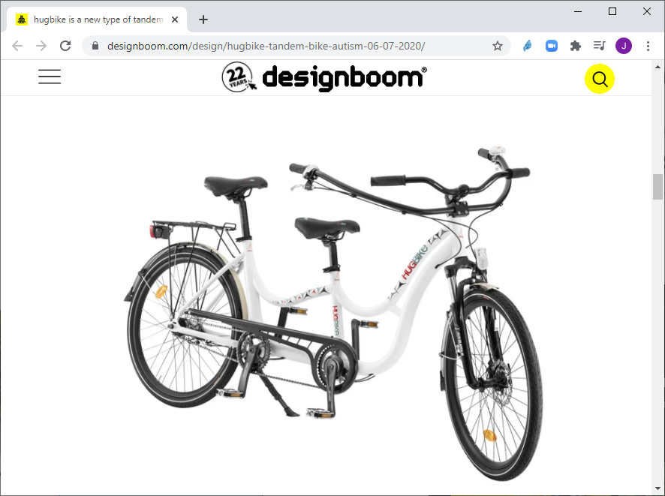
Collaborative motor actions
Definition a collaborative driving action is an action that is carried out by two people. by holding together an object
Examples
carry together a basket that is too heavy to carry alone
move a piece of furniture together by pivoting it through a door
Laurel & Hardy 'The Music Box' 1932 film
Bike with 2 handlebars

Slide 10
Collaborative motor actions
Difficulties a collaborative driving action requires a driving dialogue : you have to take into account the movements of the other person. in our own movements => this requires motor coordination in pairs : you have to adjust to each other's rhythm and posture. for example to lift an object at the same time

Slide 11
Collaborative motor actions and children with severe non-verbal ASDs
Parents of children with severe nonverbal ASDs report that their children do not help spontaneously, and the parents do not ask them to do so.
Motor coordination difficulties are a cardinal symptom of autism (Fournier et al., 2010).
Those who have difficulty coordinating one hand with the other are in more difficulty if they have to take into account the other's movement, speed, posture, anticipate the next action and how the other will position themselves to do so.

Slide 12
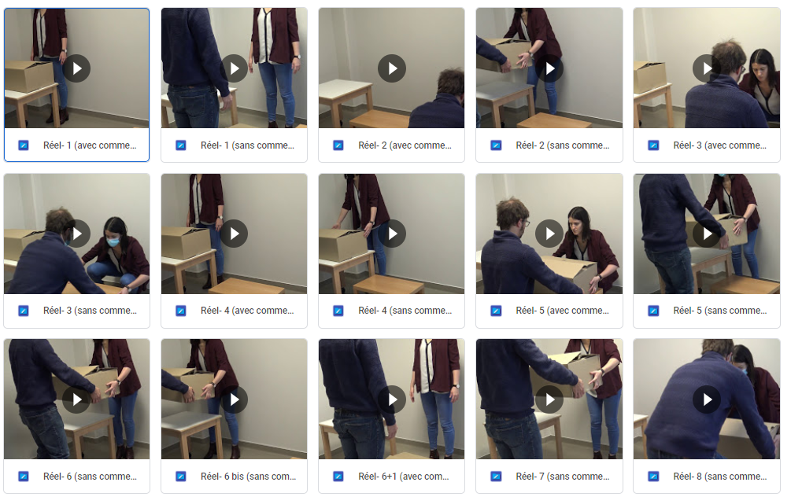
Library of collaborative motor actions without the MIMETIC platform
The "Collaborative Motor Action Library" includes videos of collaborative motor actions between adults filmed by TEDyBEAR (Jacqueline Nadel, Justin Malleret, Aurélie Cherrier).
Contact us if you wish to consult them Email : MARTIN@LIMSI.FR

Slide 13
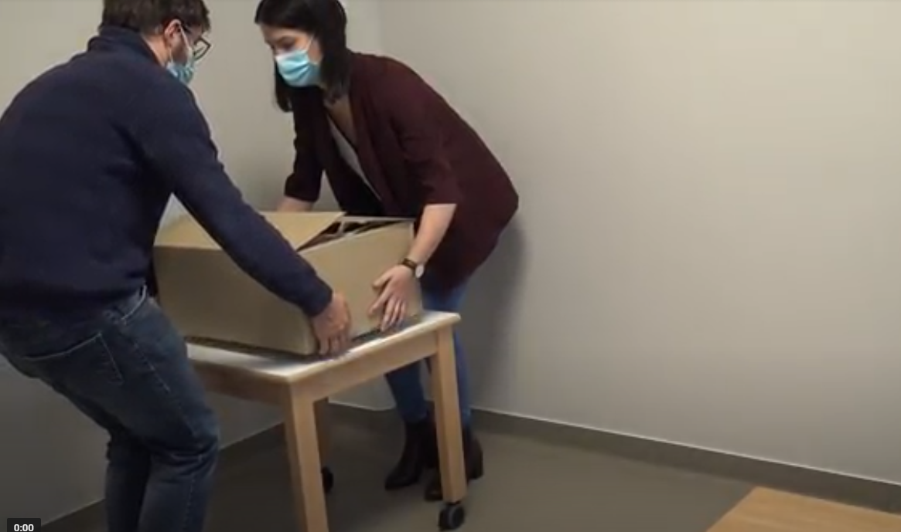
Training program
Pedagogical program and library of various collaborative motor actions of progressive difficulty designed by J. Nadel
Example :
hoist the box from the floor to the table
lower the box from the table to the floor by flying over it the stool
slide the stool to the table
at different speeds

Slide 14
PRESENTATION OF THE MIMETIC PLATFORM

Slide 15
New Technologies for Autism
Very many uses of new technologies (Grossard et al. 2018)
Rarely combine social skills training and whole body motor skills
Mainly aimed at children with Verbal Autism Spectrum Disorder
When they are only virtual, it limits the link with the physical and social context
Notes:
Grossard, C., Palestra, G., Xavier, J., Chetouani, M., Grynszpan, O., & Cohen, D. (2018). ICT and autism care: State of the art. Current Opinion in Psychiatry. https://doi.org/10.1097/YCO.0000000000000455
Grossard, C., Grynszpan, O. (2015) Digital Technology-Assisted Skills Training in Autism: A Review. Enfance, 1/2015, 67-85.

Slide 16
Objectives of the MIMETIC platform
Learn in a playful way how to position yourself in relation to a small avatar to move an object together.
The object has 2 parts:
a real part carried by the child
a virtual game carried by the small avatar
The 2 parts of the object must not come off. => you have to coordinate with the avatar

Slide 17
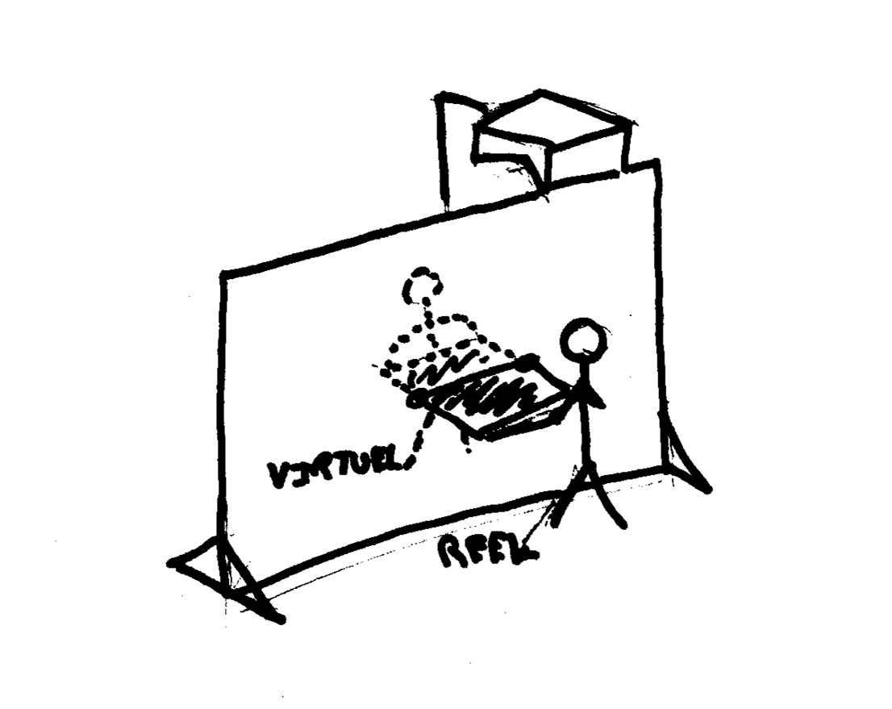
Objectives of the MIMETIC platform

Slide 18
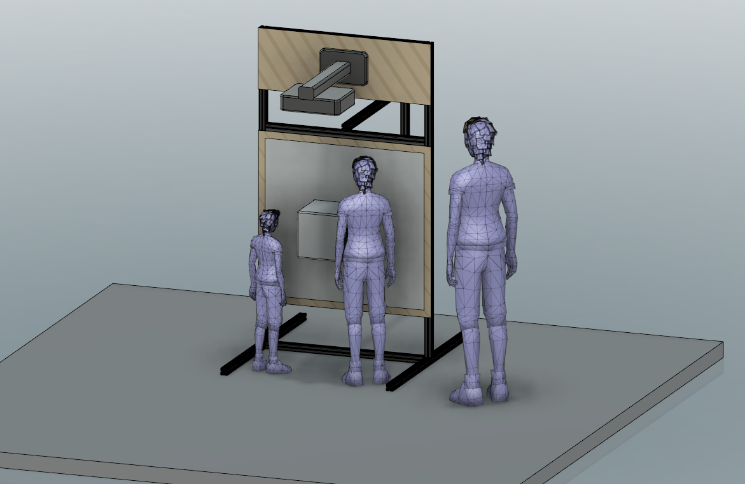
Adjustable height of the device to adapt to the size of the children

Slide 19
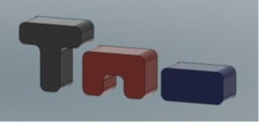
Objects of the MIMETIC platform
The table (purple)
The stool (red)
The box (blue)

Slide 20
Global view of the MIMETIC platform
a. Complete interactive installation. b. Tangible object on the wall and detached from it. c. Tracking system integrated to the rear twin object. d. Remote control to set up the training.

Slide 21
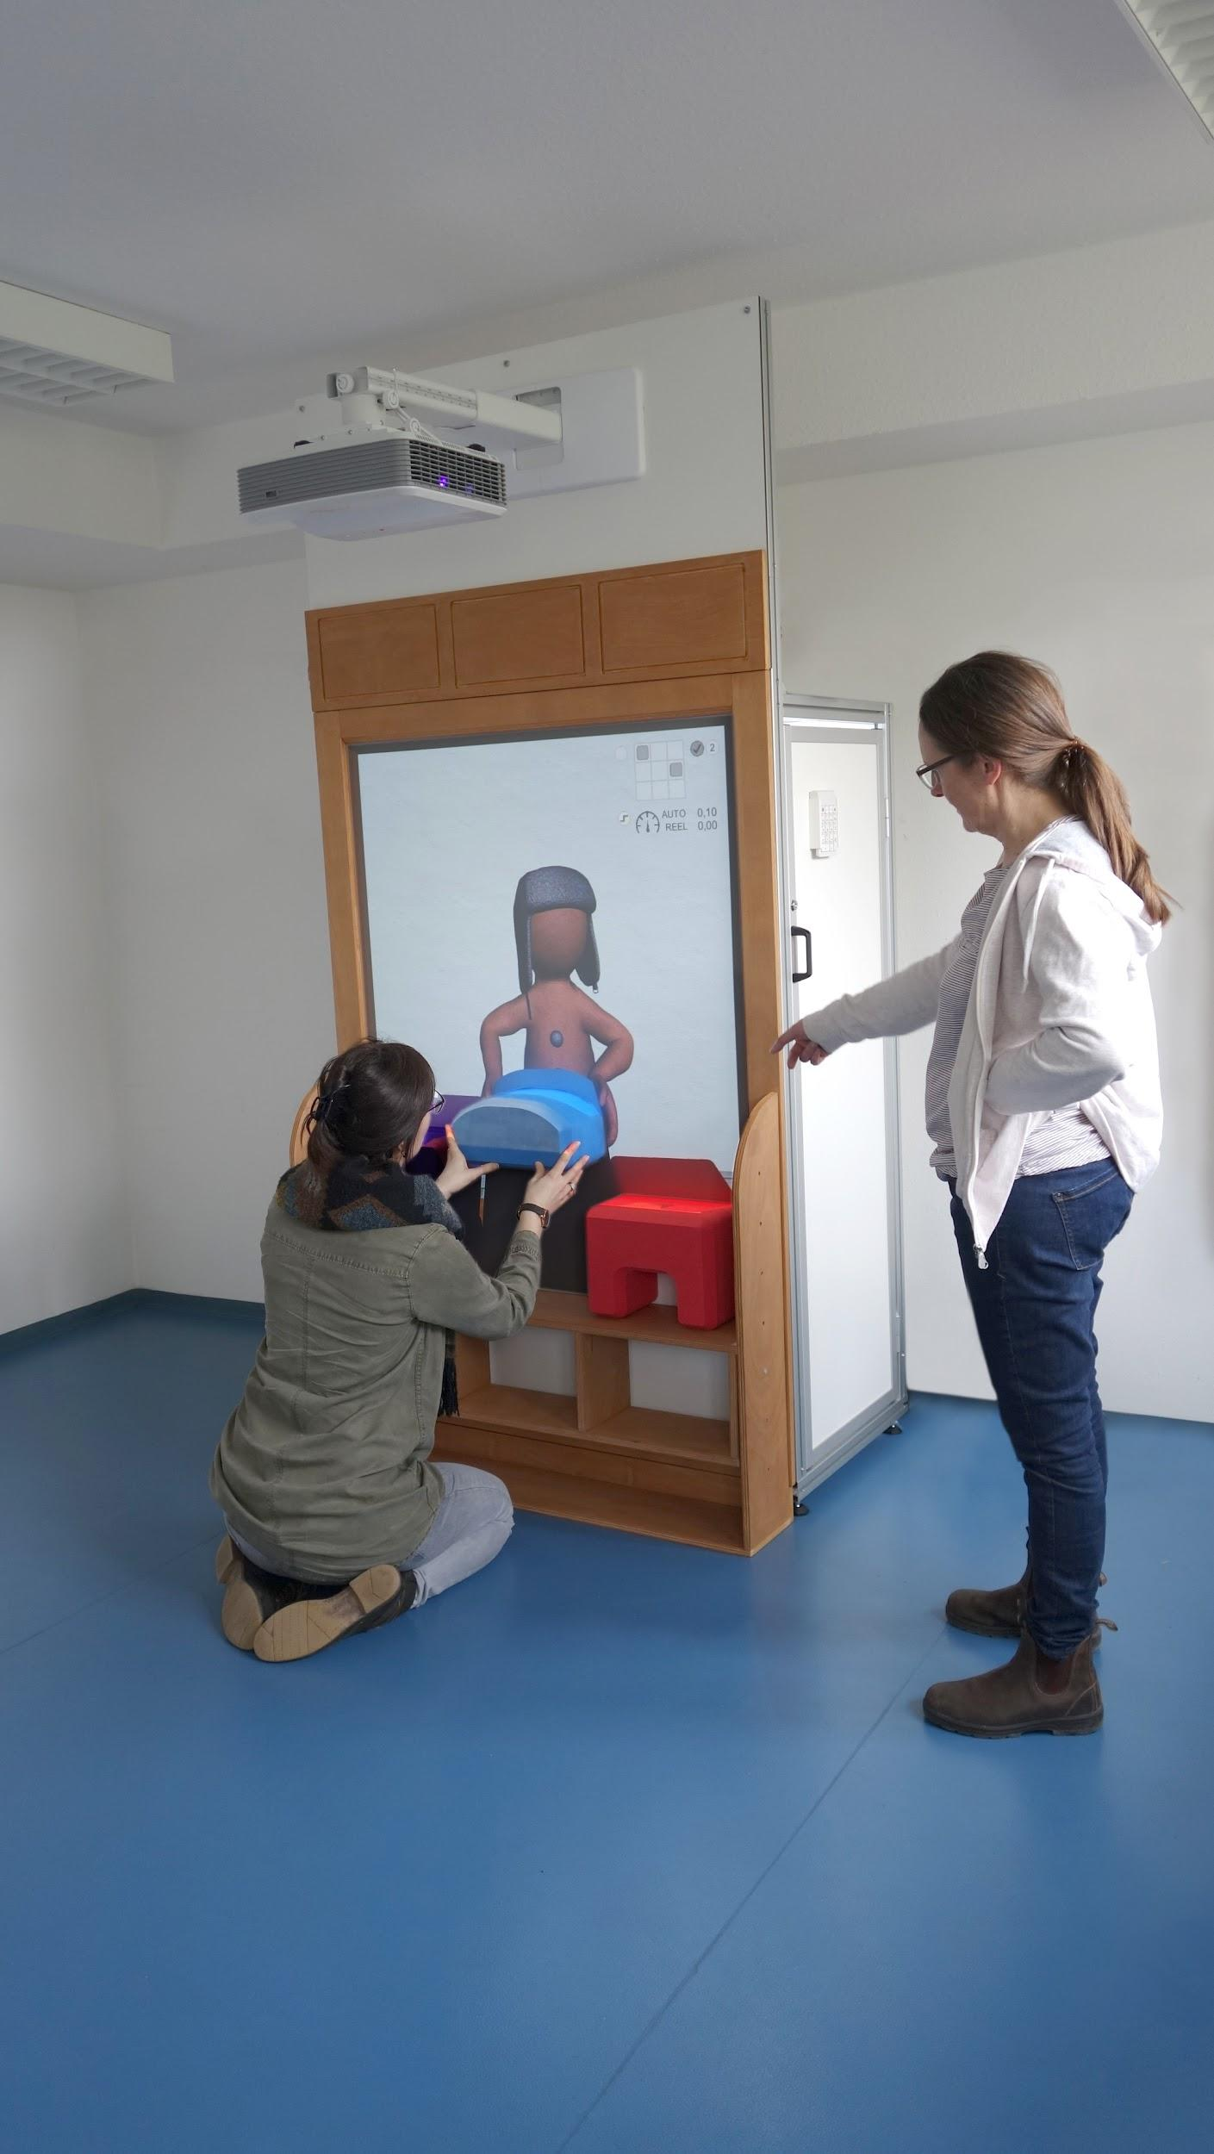
Overview of the MIMETIC platform

Slide 22
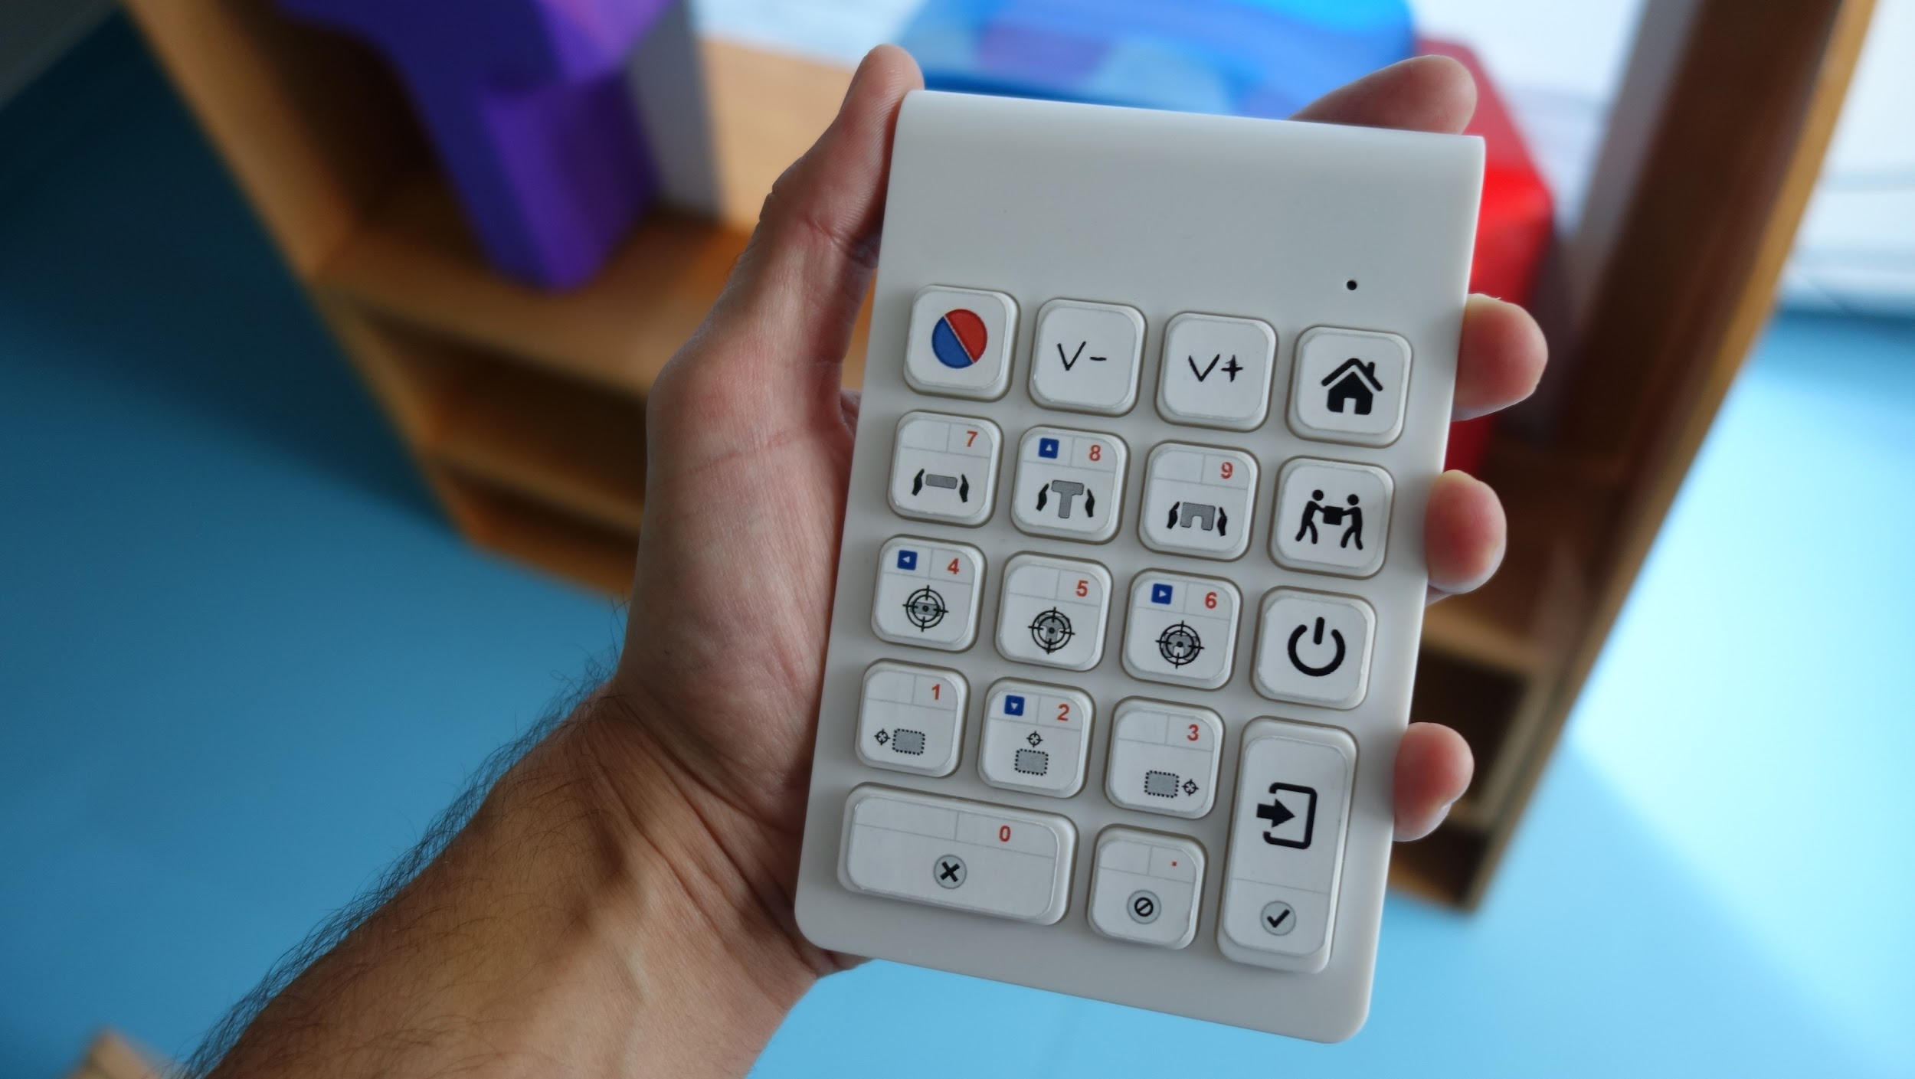
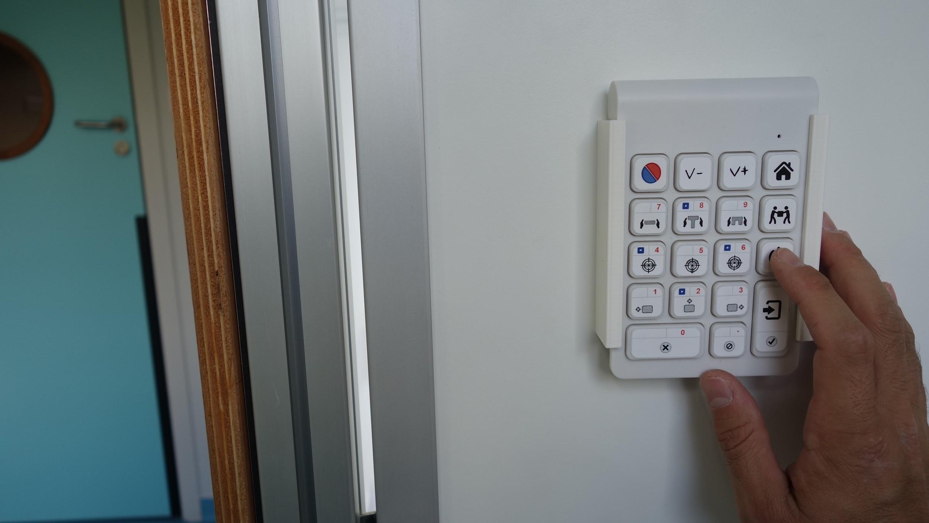
Remote control

Slide 23
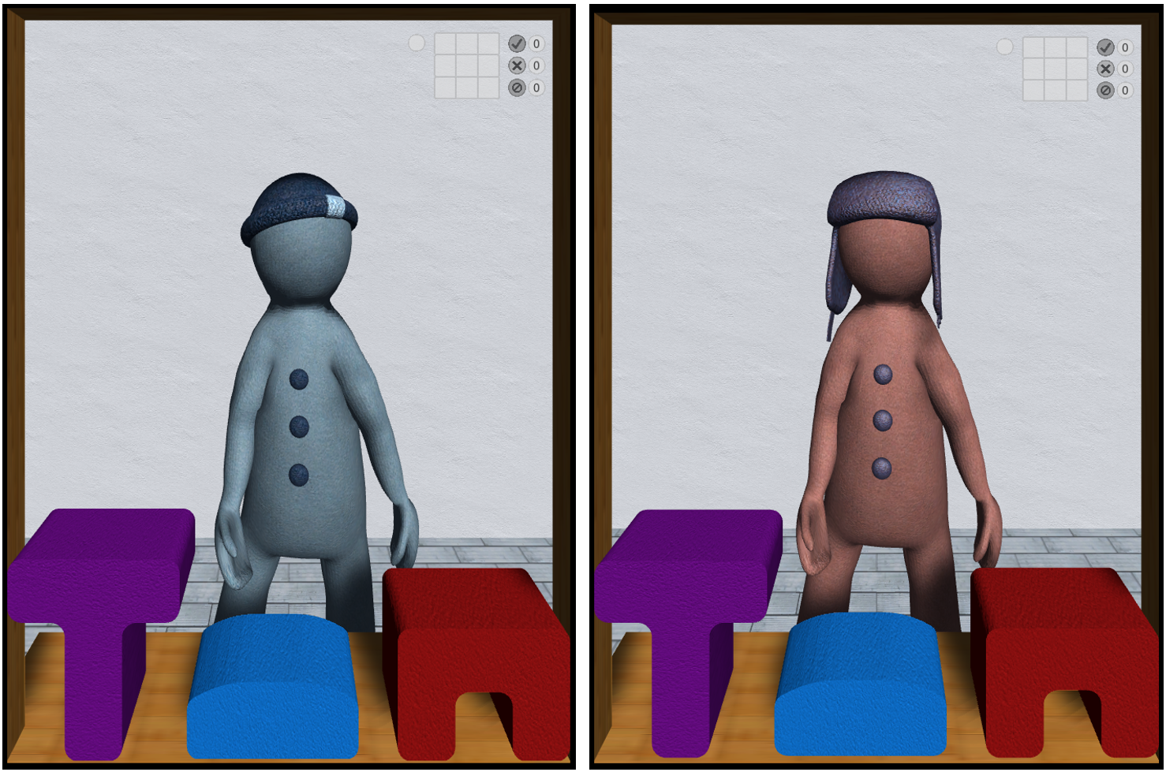
The two virtual agents
On the left: Michou (he follows the child's movements: he imitates him)
On the right : Lola (she is autonomous: the child has to follow and imitate her)

Slide 24
The two virtual agents behave differently
a. The two virtual agents b. Sequence of movements with Michou. c. Sequence of movements with Lola

Slide 25
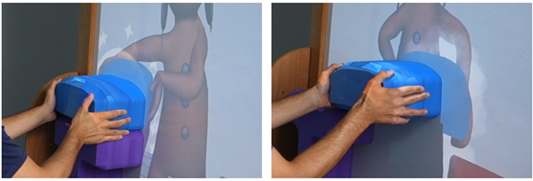
Graphic animations
Chess animation (smoke around the object)
Animation of success
(stars around the object).

Slide 26
TRAINING IN COLLABORATIVE MOTOR ACTIONS WITH THE MIMETIC PLATFORM

Slide 27
Adapt the protocol to the specifics of each child
Three phases:
a phase of familiarization with the platform
a learning phase of coordination with the avatar Michou following the child
an adaptation phase speed, route and direction of the avatar Lola that the child must follow

Slide 28
1) Familiarization phase with the platform

Slide 29
Familiarization phase with the place and the platform
be very attentive to this phase: it will condition the sequel for some children, those who have difficulty accepting change
there is an important change in a room that was reserved for another use: now there is a platform in it.

Slide 30
1) Familiarization phase with the place and the platform
If the child understands the language well enough :
we can tell him that we have installed a game and that he will be able to go and see this game if he feels like it.
perhaps several attempts before that he/she agrees to enter the transformed room.
Start by leaving the door open : he/she will eventually take a look inside.
Another time, the platform will be lit with the avatar Michou, the following one
tell the child that Michou is waiting for him or her and ask him if he wants to play with him.

Slide 31
1) Familiarization phase with the platform
If the child is non-verbal
a picture of the platform will be prepared on a shelf in the room
we will show the photo to the child and show the room, door open
Another time, as before, we'll light the platform and mime an action with Michou, then we'll give the place to the child who will take it if he wants.
we won't insist. It is better to be patient and to have a good acceptance of the place and the platform, it is the guarantee of a successful training.

Slide 32
1) Familiarization phase with the platform
See the deliverable "Training Guide for Caregivers for more suggestions on how to prepare children to accept the platform

Slide 33
1) Familiarization phase with the platform
If the child refuses or shows discomfort
It is best to forego training for this child.
He may later accept when he sees others coming with pleasure to this room and use the platform: remote observation often makes fears and resistances disappear.
For other children, this phase is not necessary. They will gladly enter the room and want to participate right away.

Slide 34
2) Learning phase of coordination with the Michou avatar who follows the child

Slide 35
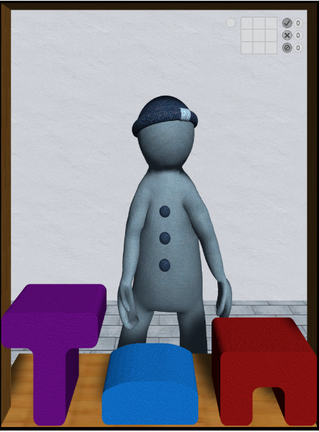
2) Coordination learning phase with the avatar Michou who imitates the child
^{1st} difficulty
The child must understand that he or she must grasp the real object. but without detaching it from the virtual object it sees.
on the screen
This is the first difficulty because spontaneously the child tends to take the object.
If he takes it, he detaches it from the virtual object and no action with Michou can be performed since the virtual object is not a virtual object. and the real object are no longer in contact.

Slide 36
2) Coordination learning phase with the avatar Michou following the child
Whether the children are verbal or not, a good way to get started is to a direct demonstration :
"You see, you have to slide the box and Michou slides it too. We can go and put the box on the stool, or on the table or on the floor. There it is on the stool, we'll try to put it on the table by sliding it".
For non-verbal children, we can mime several times the useful gestures by insisting on the gesture of sliding .

Slide 37
2) Coordination learning phase with the avatar Michou following the child
Some children understand very quickly but for others it is very difficult to control oneself not to take the object in hand.
Misfires can last a very long time or even reappear at the beginning of the next session after the child has understood:
it's so intuitive to take the object and move it from one point to another!
in this situation, your presence and your encouragement are essential: ' Yes! it's almost good, you're going to make it! let's do it again! come on, let's do it again! bravo you made it slide a little! ‘

Slide 38
2) Coordination learning phase with the avatar Michou following the child
To this difficulty is added the need to to fight gravity by sliding a magnetic object that resists the thrust (that's what makes it look heavy).
When you have to move the object by lifting it, work against gravity is at its peak.
When you have to move the object by lowering it, another difficulty appears, you have to slow down your gesture, otherwise the object will fall, always because of gravity.
It is therefore necessary to control its strength and stabilize its movement in hypertonia, which explains many misfires.

Slide 39
2) Coordination learning phase with the avatar Michou following the child
2nd difficulty
It must be controlled throughout the scenario that the adhesion between the real object and the virtual object is maintained.
it is necessary at the same time
continue to drag the object and remember the goal (e.g. put the stool next to the table).
You can help him by reminding him of the goal: 'we're going to the table, keep going, we're not there yet'.
This aspect of training can be used as a therapy in all cases where the child quickly loses the objective of his actions. As we know, the ability to maintain a goal is often lacking in Autism Spectrum Disorder.

Slide 40
2) Coordination learning phase with the avatar Michou following the child
3rd difficulty
Perform 4 scenarios representing 4 different routes :
lift the box of the stool on the table ;
Slide the stool next to the table ;
Take the box from the table and place it on the stool;
Take the box from the stool and place it on the floor.
The setpoint is
verbal for children with small language,
modeled by directly showing the action to be carried out for non-verbal children.
It is necessary that the children understand and follow the instructions, even if they would like to make their own itinerary.
It's about being able to inhibit your internal motivation. in order to carry out the requested action.
This ability to control one's motivations is often very weak in our children.
The device therefore offers the possibility to train these executive difficulties in a playful way.

Slide 41
2) Coordination learning phase with the avatar Michou following the child
The training phase with Michou is effective if all four scenarios are successful :
drag the real object along the wall instead of taking it,
make the virtual object adhere to the real object,
maintain grip throughout the course
not to give priority to one's own motivation by carrying out personal journeys that do not follow the instructions.

Slide 42
3) Phase of adaptation to the speed, path and direction of the avatar that the child must follow.

Slide 43
3) Phase of adaptation to the speed, path and direction of the avatar that the child must follow.
By her gesture, the avatar Lola indicates which object she is going to move: she turns her head towards the place where she is going to place the object.
It is she who decides which object to take, where to go and how fast.
The child no longer has a protocol to carry out by following an instruction ('you are going to put the box on the table that is on the stool'). => he has to follow Lola: it's more difficult
First of all you need to understand which object Lola has chosen to take.
She has her hands on it so it's not the most complicated, but you have to imitate her choice and grab the same object.

Slide 44
3) Phase of adaptation to the speed, path and direction of the avatar that the child must follow.
You will see some children in difficulty because they would prefer to take another object.
You may have to make them try several times so that they understand that in this case obviously the action cannot be carried out.
This is an opportunity to learn the limits of one's good will. Here again, it will take tact not to discourage the child.
Some say on this occasion that they prefer Michou: obviously with Michou you do what you want.

Slide 45
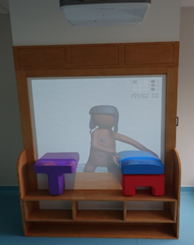
3) Phase of adaptation to the speed, path and direction of the avatar that the child must follow.
Lola is turned towards the place where she is going to go: she indicates a direction.
It is very interesting to note that children very quickly identify his posture as a kind of scoring.
This can move them toward an understanding of joint attention.
It's up to you to take this information into account to help them progress, so that they learn that the posture and orientation of the head indicate a goal: it's a good playful opportunity to do so.
Lola is ready to lift the blue box she looks at the purple table where she's going to put the blue box

Slide 46
3) Phase of adaptation to the speed, path and direction of the avatar that the child must follow.
A) Follow Lola in optimal speed
the one the child had when he practiced with Michou : with Michou he would take the speed he wanted.
It is this speed that Lola chooses in the first session.
=> the child has to take the object that Lola has taken virtually, He must be prepared to go in the direction that Lola's posture indicates, and he must follow Lola's speed which is his preferred speed.
=> The greatest and only difficulty is to understand that it is Lola who decides and that one can neither choose the object nor where to put it.

Slide 47
3) Phase of adaptation to the speed, path and direction of the avatar that the child must follow.
B) Follow Lola at high speed
The fast speed is chosen by the adult who controls the experience with the box.
It must be sufficiently different from the optimal speed for the child to feel it and be forced to hurry.
Going fast and keeping his object in contact with the virtual object requires the child to pay a lot of attention to the movement of the virtual object.

Slide 48
3) Phase of adaptation to the speed, path and direction of the avatar that the child must follow.
C) Follow Lola in slow speed
The slow speed is chosen according to the child's optimal speed so that the child clearly feels the need to slow down.
=> Most difficult synchronization :
the slowness multiplies the problems of resistance to gravity.
The slower you have to raise the box, the longer and more persistent the effort.
To get there, you have to brace yourself, tighten your body, spread your legs to find a better balance, sometimes even get on your knees.
Each child will do it in a different way. It's up to you to guide them to find the right way to succeed: 'you can spread your legs; you can get on your knees, it will be easier'.

Slide 49
3) Phase of adaptation to the speed, path and direction of the avatar that the child must follow.
C) Follow Lola in slow speed (continued)
You can mime, but never forget that everyone has their own balance and motor skills.
It is useless to want the child to do exactly as you do because he doesn't have the same body, the same tone, the same capacity for resistance.
So 'look how I do it' is not the best formula unless you propose several postures between which the child can find the one that suits him.

Slide 50
3) Phase of adaptation to the speed, path and direction of the avatar that the child must follow.
C) Follow Lola in slow speed (continued)
It is not easier to bring down an object very slowly.
Here we have to brake even more than at other speeds, while gravity causes us to go fast or even to drop the object.
The control of its movement is crucial.
You will again be able to take information about the child's motor coordination abilities and the stability of his posture .

Slide 51
Evaluation

Slide 52
Evaluation with children with TEDyBEAR ASD
(Nadel & Martin, ARAPI Newsletter forthcoming) (Nadel et al. in preparation)
12 children from 4 to 9 years old
4 are able to carry out the 3 tasks with the autonomous agent (preserved 3 weeks later)
5 are unable to go beyond familiarization and the helping agent
2 children do not support the device (for one it would be necessary that the stool touches the table, for the other, the failure is unbearable)

Slide 53
Evaluation with children with TEDyBEAR ASD
(Nadel & Martin, ARAPI Newsletter forthcoming) (Nadel et al. in preparation)
633 trials in total
Difficulties
drag, not pick up the object
fight against gravity
control the adherence of the real object to the virtual object
control its speed

Slide 54
Trajectory visualization program
Different visualizations of a child's trajectories with Michou following (a and b) and with Lola following (c and d) are available.
a. The child's movement gradually accelerates. b. The child explores by first climbing the object very high before returning to the initial position and making the requested trajectory. c. The child gradually moves away from Lola's path (black line). d. the child follows the agent and adapts his movement to stay aligned with him.

Slide 55
TECHNICAL :
PLATFORM COMPONENTS AND ASSEMBLY

Slide 56
Technical Appendix
The "Technical Appendix" deliverable includes
Pictures of the assembly of the platform
4 videos of the assembly of the platform
The specifications and estimates of the different components

Slide 57
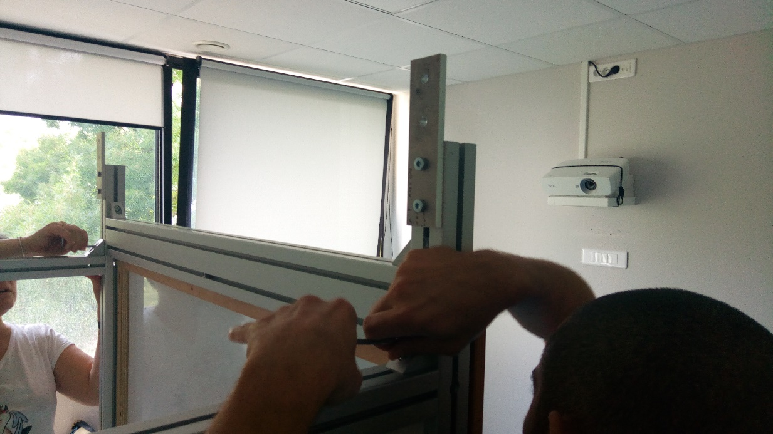
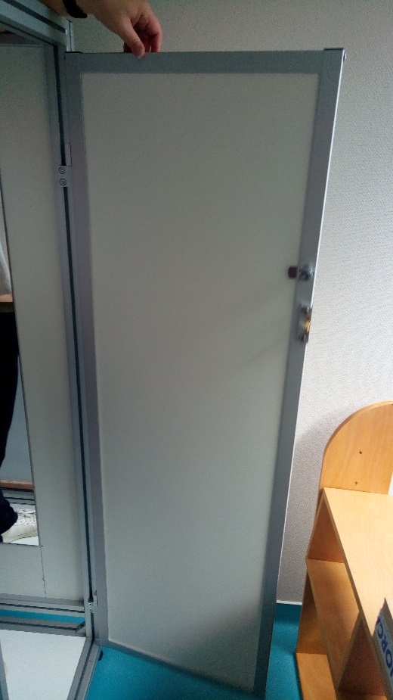
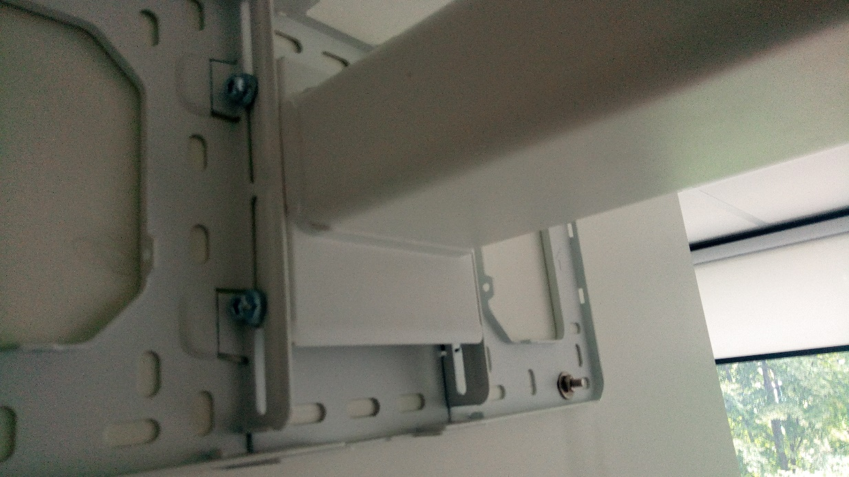
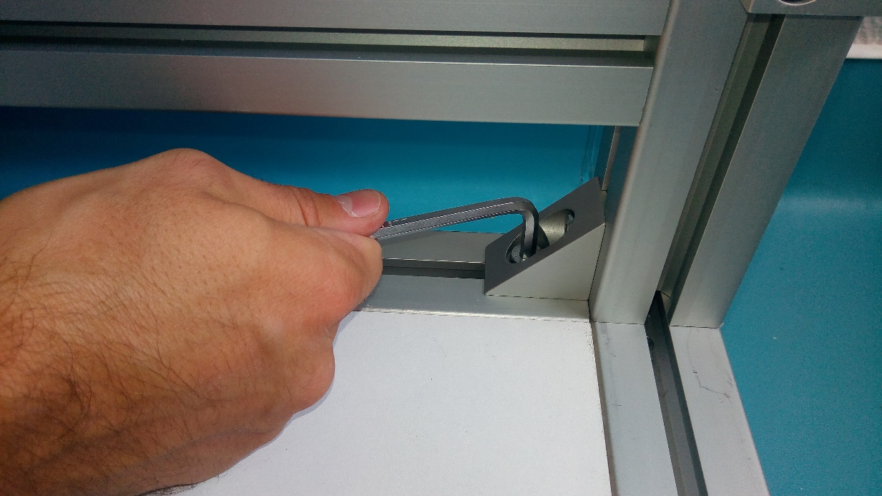
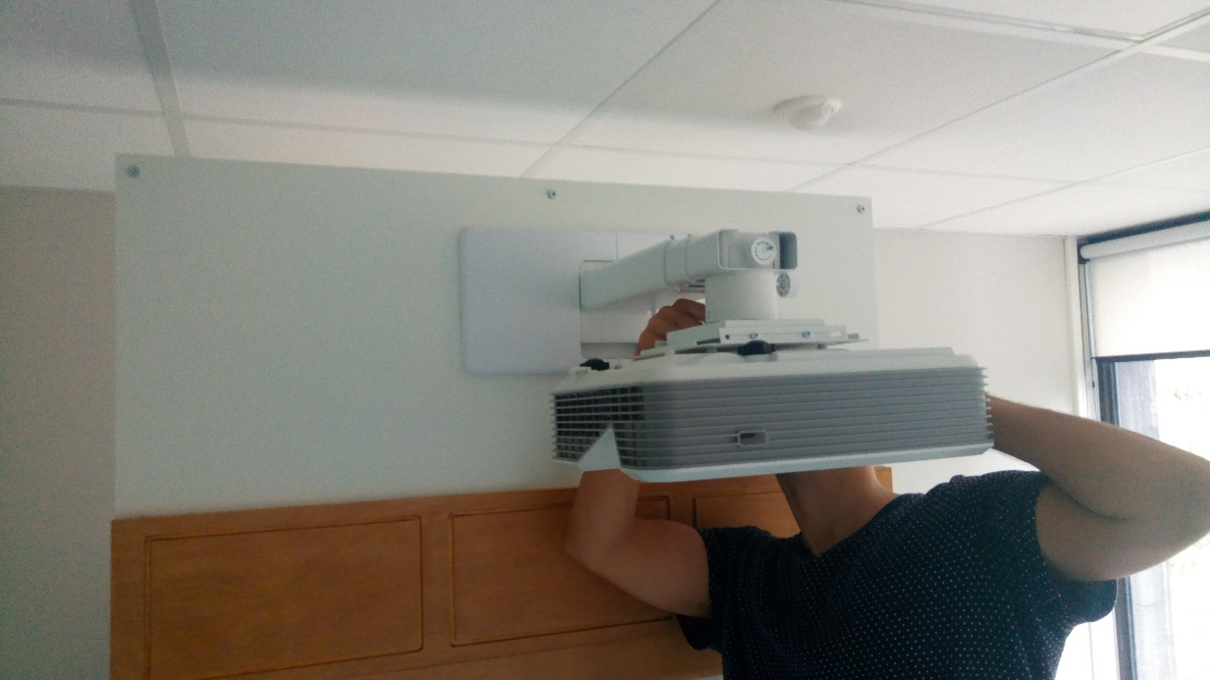
Photos of the platform assembly

Slide 58
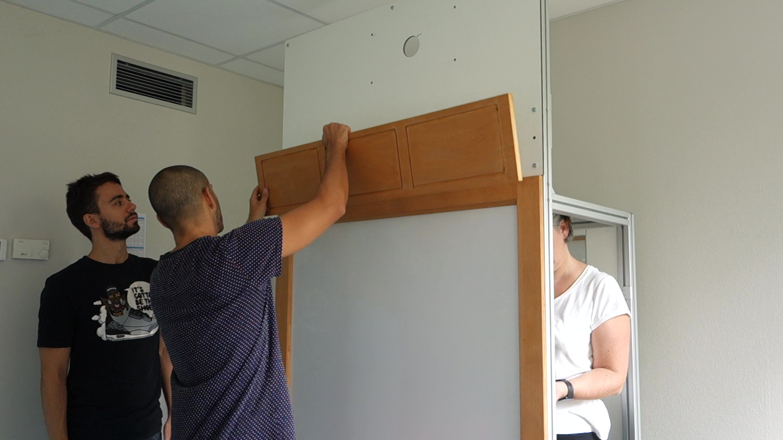
4 videos explaining how to mount the platform (total duration 1 hour)

Slide 59
Available Resources
The project website https://mimetic.limsi.fr/ with deliverables / application supports :
Deliverable 7 : "Training guide for caregivers".
Deliverable 6 : "Library of collaborative motor actions". filmed by TEDyBEAR (Jacqueline Nadel, Justin Malleret, Aurélie Cherrier)limsi.fr
Deliverable 8 : "Extension actions and communications".

Slide 60
Find the results of the search on :
https://mimetic.limsi.fr/
https://www.firah.org/fr/logiciel-pour-l-entrainement-combine-a-l-interaction-sociale-cooperative-et-a-l-apprentissage-moteur.html

